Slide 1
Major Topics in Artificial Intelligence

Slide 2
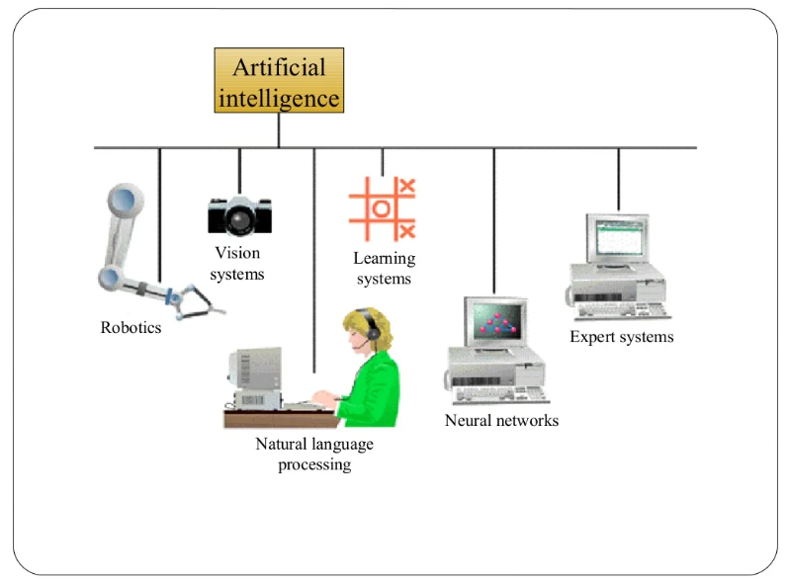
Components of AI

Slide 3
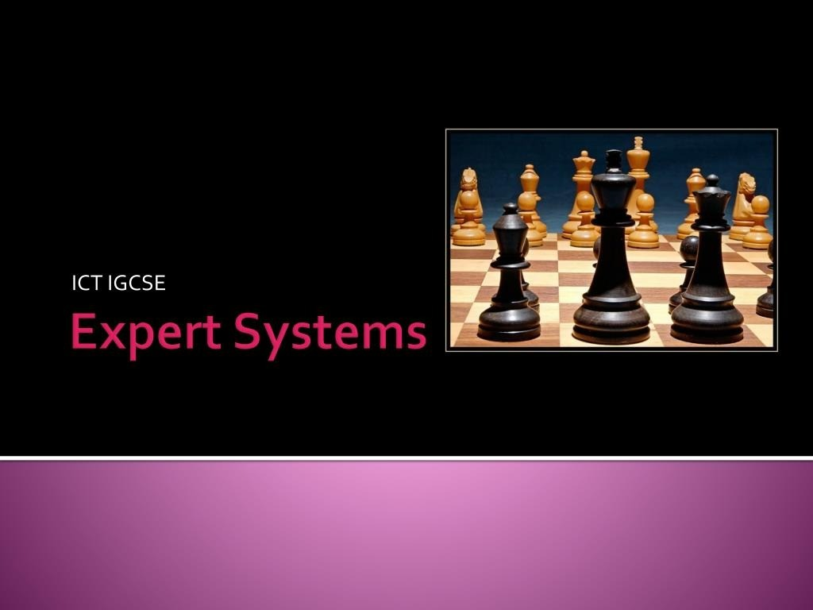

Slide 4
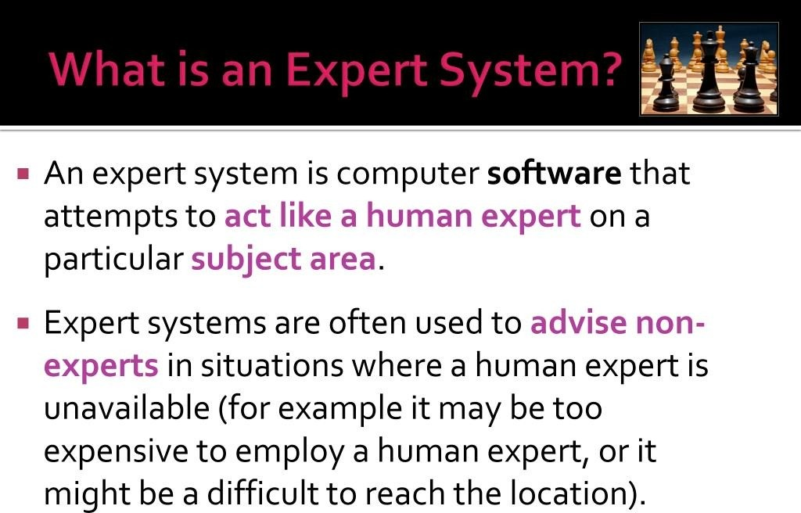

Slide 5
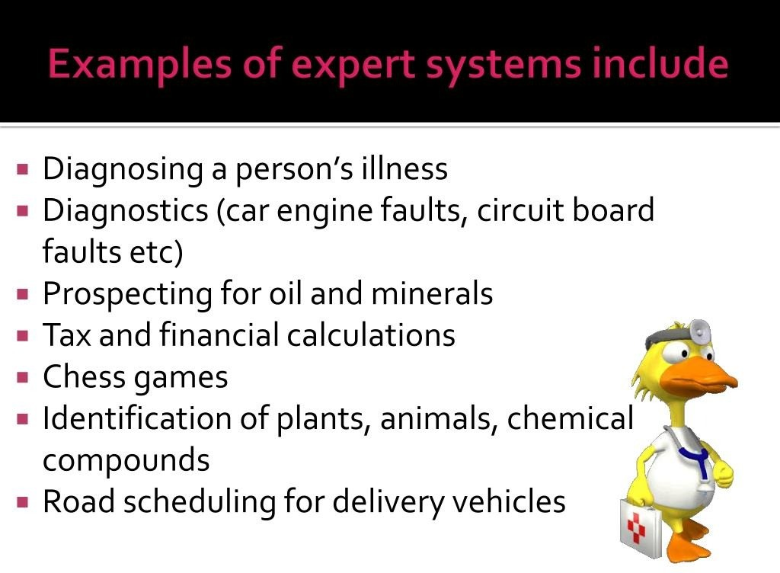

Slide 6
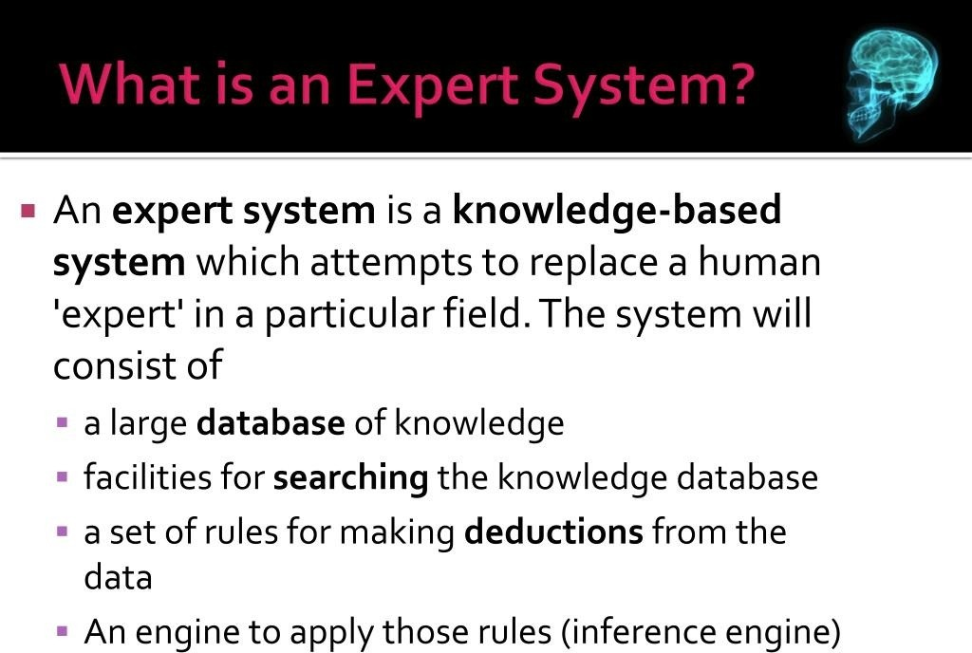

Slide 7
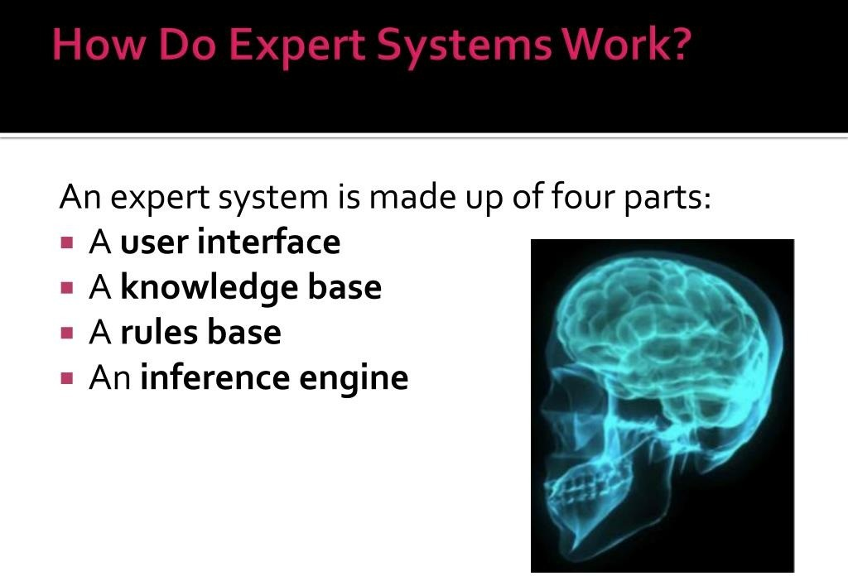

Slide 8
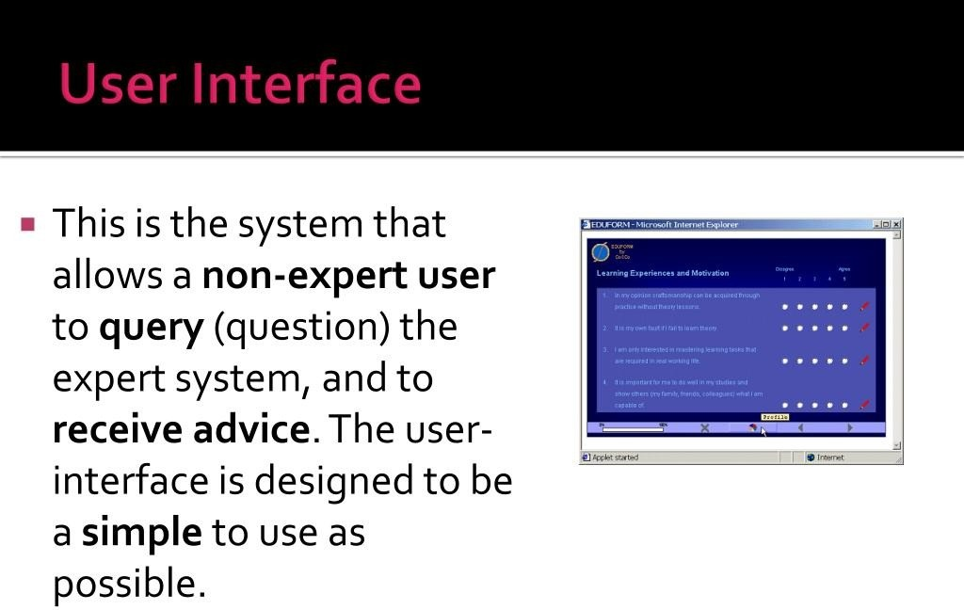

Slide 9
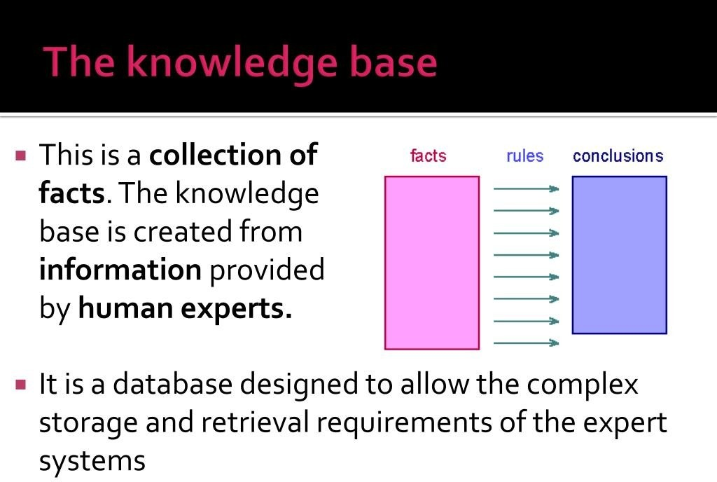

Slide 10
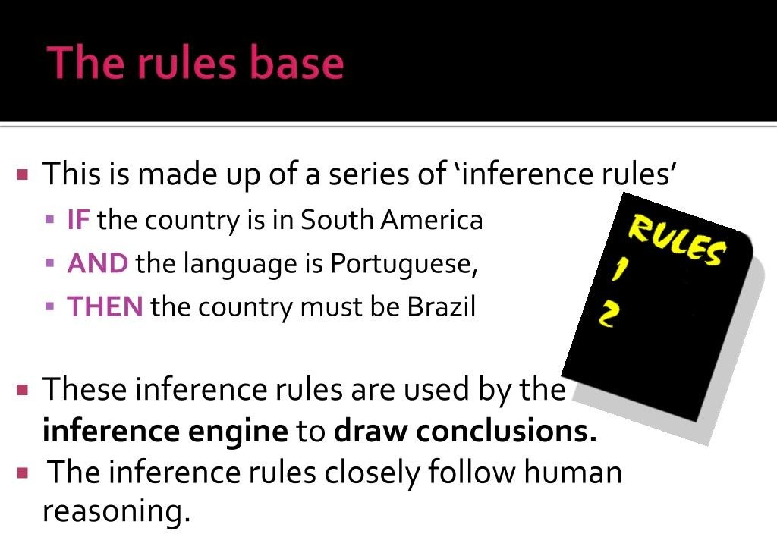

Slide 11
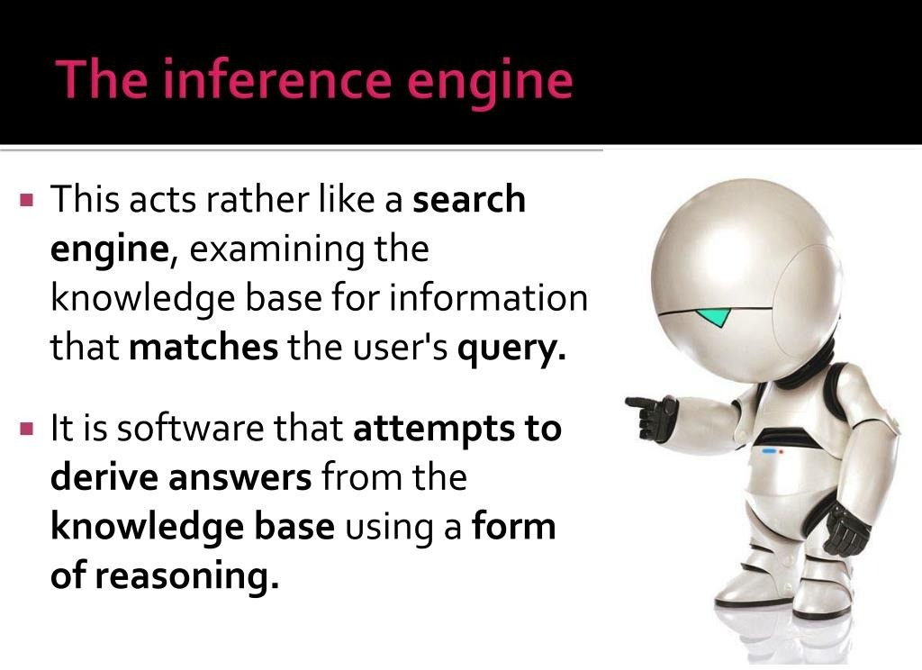

Slide 12
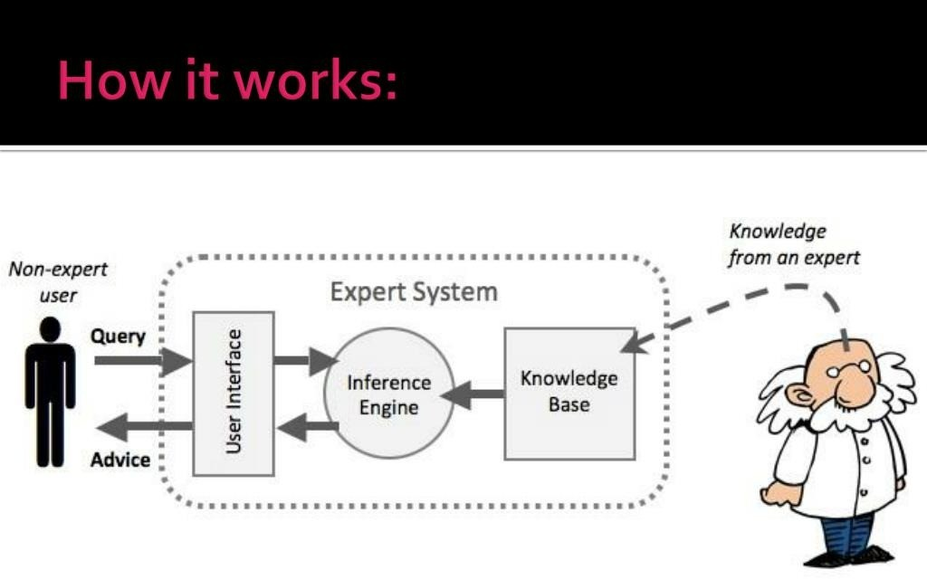

Slide 13
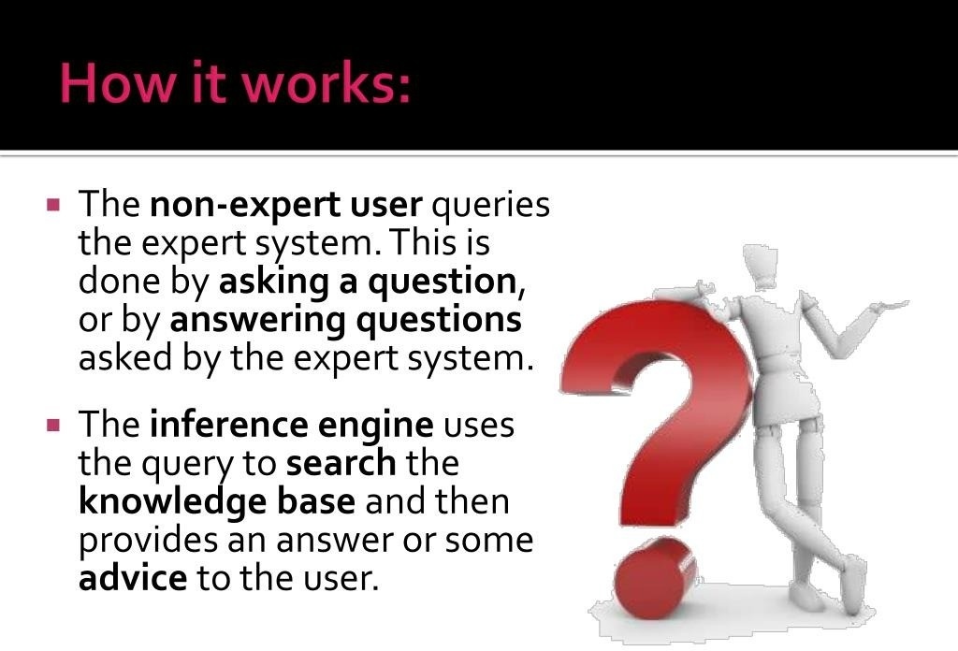

Slide 14
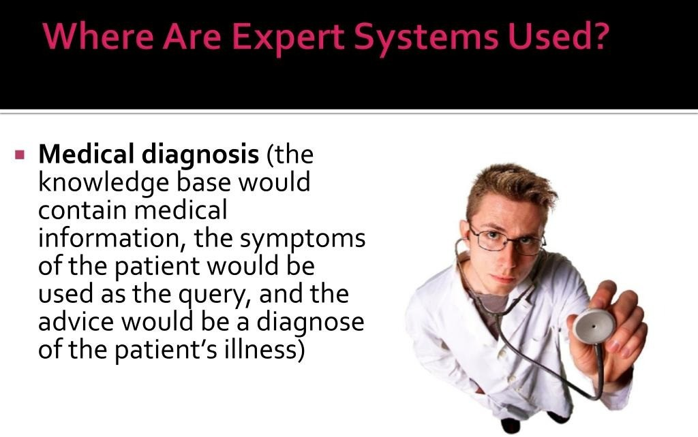

Slide 15
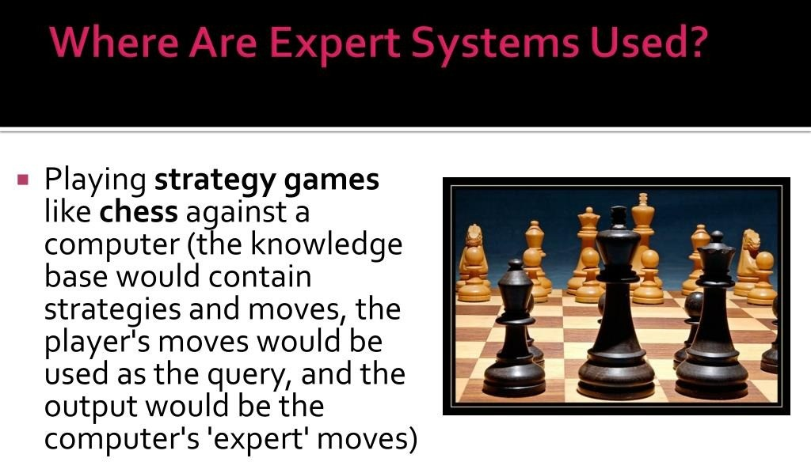

Slide 16
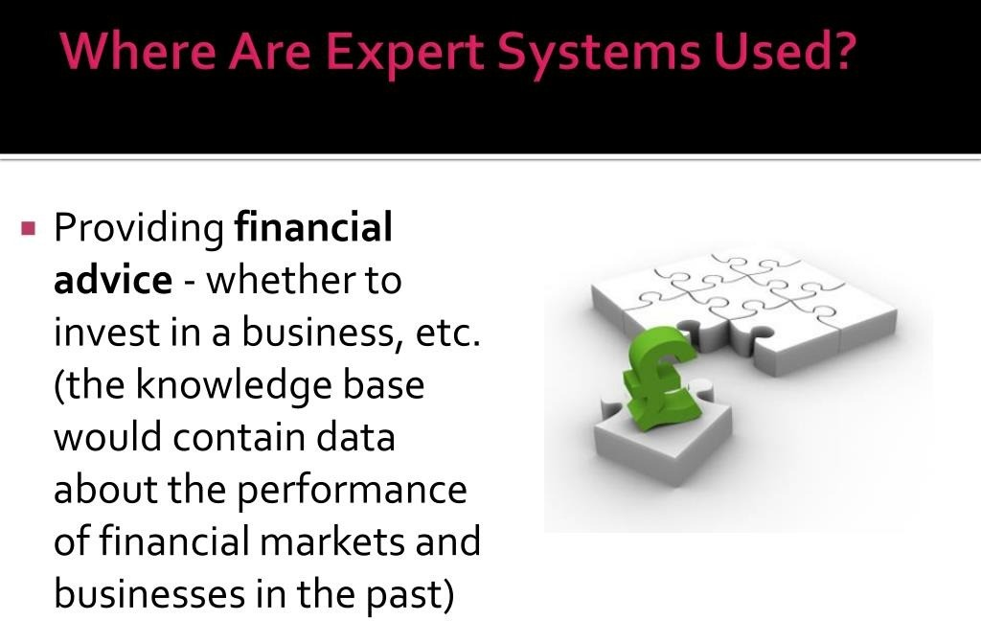

Slide 17
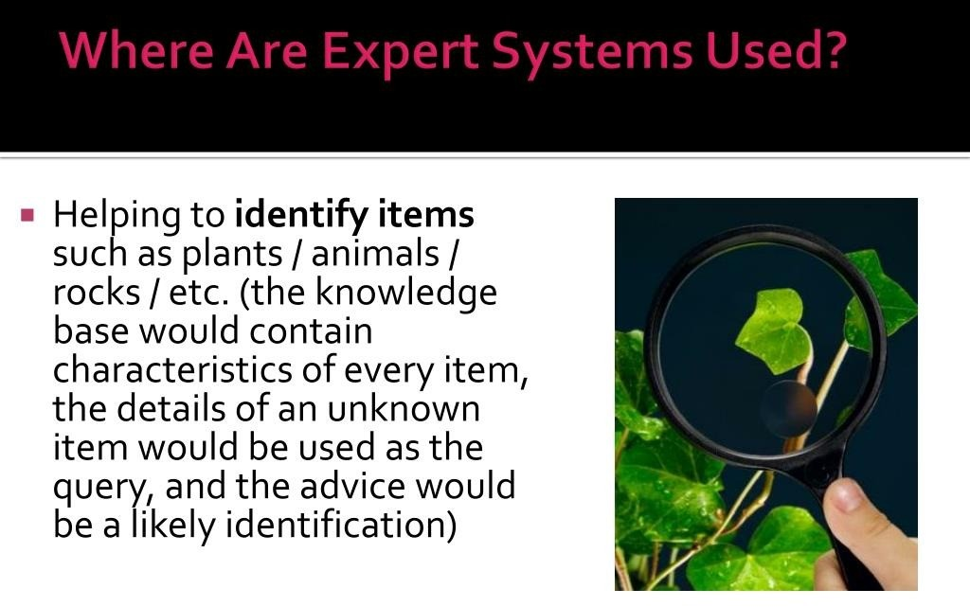

Slide 18
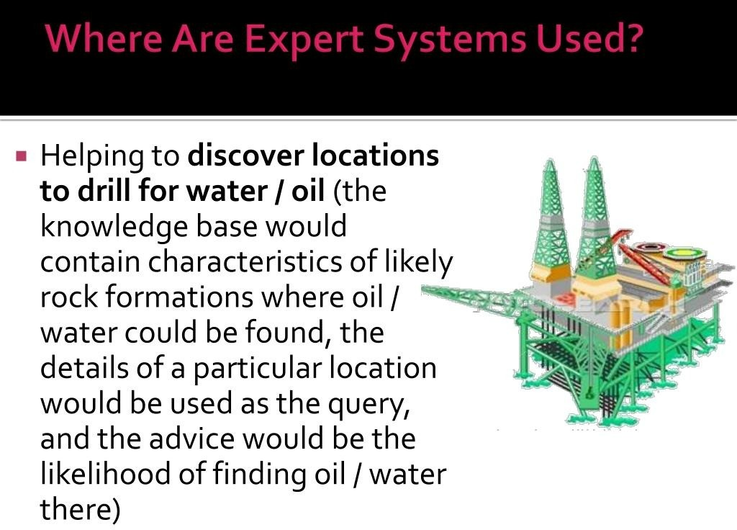

Slide 19
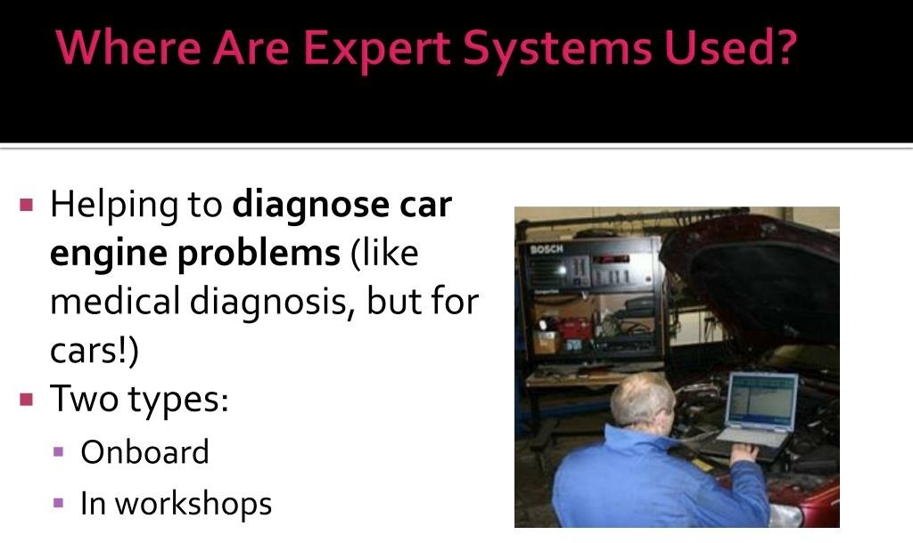

Slide 20
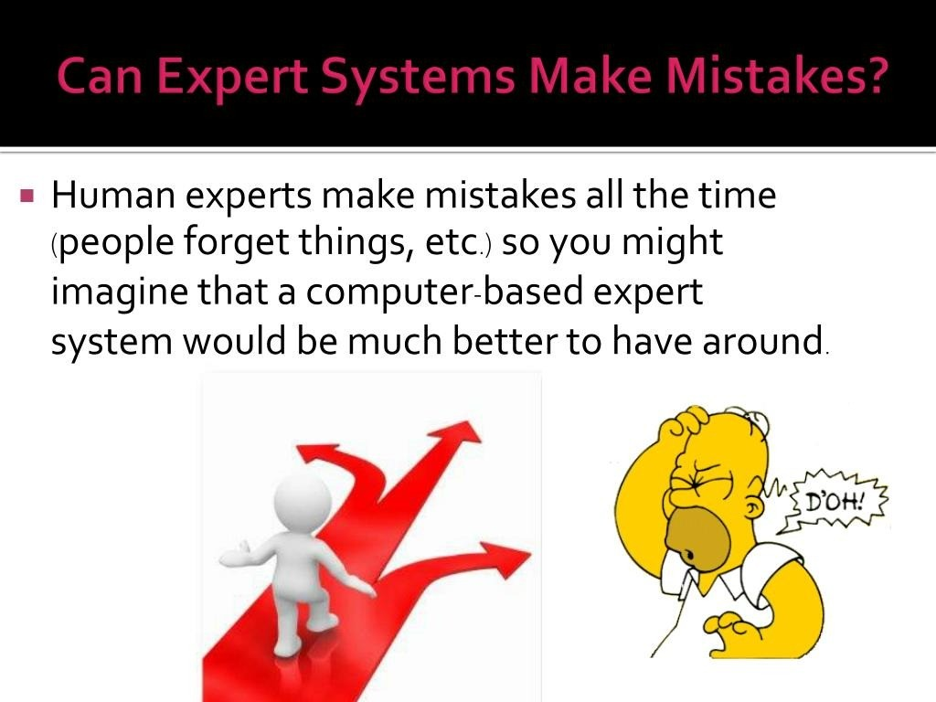

Slide 21
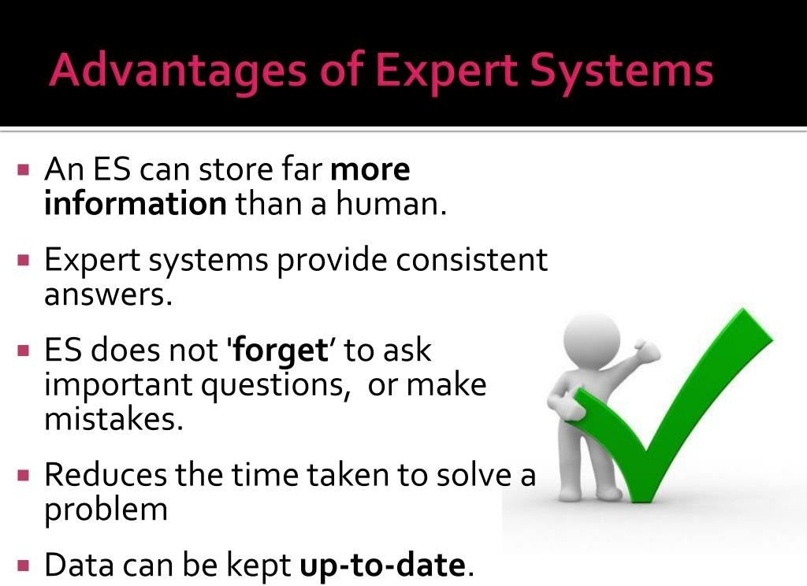

Slide 22
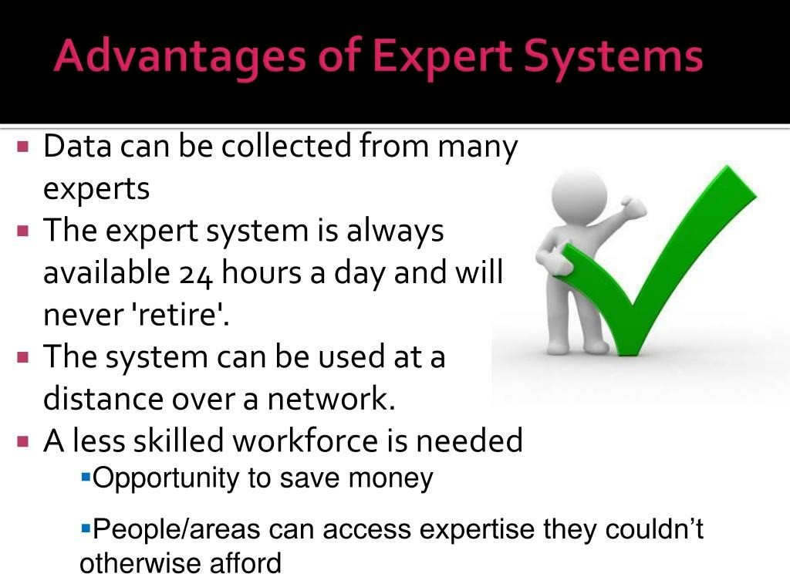

Slide 23
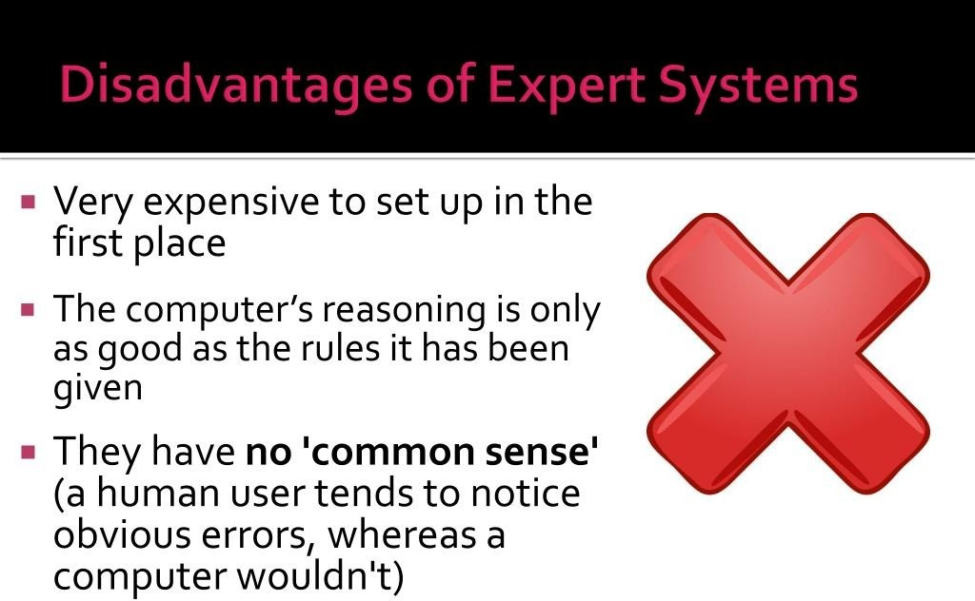

Slide 24
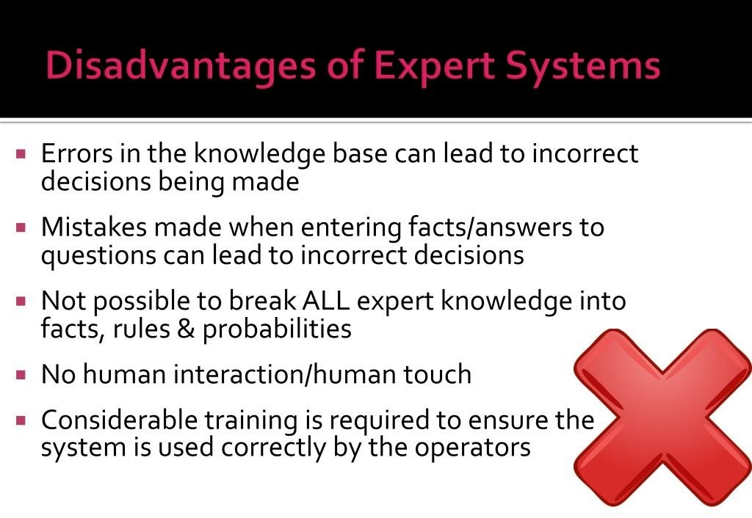

Slide 25
Natural Language Processing

Slide 26
What is NLP
D Natural Language processing (NLP) is a
field of computer science and linguistics concerned with the interactions between computers and human (natural) languages.
D Goal
Natural Language Understanding
Natural Language Generation

Slide 27
Automatic summarization
Example Applications
Machine Translation
Information Retrieval
Question Answering system
Foreign language written aid

Slide 28
Problems
D Natural Languages are very complex
Many words have various meaning
The number of relevant dependencies is
much too large and those dependencies are
too complex

Slide 29
Major Approaches
Rule based NLP
Handcrafted linguistic rules
Very labour-intensive and difficult to scale up
Example based NLP
Search for similar examples from training
data
D Statistical based NLP
Learn from training data and generate natural
language

Slide 30

bing.
-
Translator
Home I Tools I Help
Free online translation servic
Languages
ChineseSimplified
.. English
Translate c
Enter text or webpage URL
sl1'.-r, f i.t
Baidu, you'll know
Rate this translation: w
Tbot is an automated buddy that provides translations for Windows Live Messenger. It was first launched in 2008 as a prototype and has since become immensely popular. You can have one-on-one conversations with Tbot or invite friends who speak different languages with Tbot translating for you.
Simply add mtbot@hotmail.com to your Messenger contacts.

Slide 31
Information Retrieval
D Language Model Retrieval
Similar as Statistical based Machine translation approach
NLP technologies are not widely used in web search

Slide 32
Foreign Language Writing aid
D Microsoft Grammar checker
English Second Language (ESL) Assistant
□ Example based approach

Slide 33
Information extraction
D Email2DB
□ Get stock information from emails and stored in the database
D AddressDoctor
Analyze unstructured or partly structured addresses and divide them into individual elements
Recognize countries (by Name, ISO codes, major cities, etc.)
Format addresses according to the postal rules of all licensed countries
Standardize address elements (i.e. avenue -> ave, street -> st or vice versa)
D Mainly rule based approach

